Slide 1
Discriminant Analysis Fisherfaces
Tae-Kyun Kim
Senior Lecturer
https://labicvl.github.io/

Slide 2
Some references
ICML 2018
Max-Mahalanobis Linear Discriminant Analysis Networks, Tianyu Pang · Chao Du · Jun Zhu
Discovering Interpretable Representations for Both Deep Generative and Discriminative Models, Tameem Adel · Zoubin Ghahramani · Adrian Weller
Mixed batches and symmetric discriminators for GAN training, Thomas LUCAS · Corentin Tallec · Yann Ollivier · Jakob Verbeek
Batch Bayesian Optimization via Multi-objective Acquisition Ensemble for Automated Analog Circuit Design, Wenlong Lyu · Fan Yang · Changhao Yan · Dian Zhou · Xuan Zeng
High-Quality Prediction Intervals for Deep Learning: A Distribution-Free, Ensembled Approach, Tim Pearce · Alexandra Brintrup · Mohamed Zaki · Andy Neely
Generalized Robust Bayesian Committee Machine for Large-scale Gaussian Process Regression, Haitao Liu · Jianfei Cai · Yi Wang · Yew Soon ONG
NIPS 2018
Discrimination-aware Channel Pruning for Deep Neural Networks, Zhuangwei Zhuang · Mingkui Tan · Bohan Zhuang · Jing Liu · Yong Guo · Qingyao Wu · Junzhou Huang · Jinhui Zhu
Hunting for Discriminatory Proxies in Linear Regression Models, Samuel Yeom · Anupam Datta · Matt Fredrikson
Virtual Class Enhanced Discriminative Embedding Learning, Binghui Chen · Weihong Deng · Haifeng Shen
Power-law efficient neural codes provide general link between perceptual bias and discriminability, Michael Morais · Jonathan W Pillow
Unsupervised Text Style Transfer using Language Models as Discriminators, Zichao Yang · Zhiting Hu · Chris Dyer · Eric Xing · Taylor Berg-Kirkpatrick
Why Is My Classifier Discriminatory?, Irene Chen · Fredrik Johansson · David Sontag
Learning from discriminative feature feedback, Sanjoy Dasgupta · Sivan Sabato · Nicholas Roberts · Akansha Dey
On preserving non-discrimination when combining expert advice, Avrim Blum · Suriya Gunasekar · Thodoris Lykouris · Nati Srebro
Sample-Efficient Reinforcement Learning with Stochastic Ensemble Value Expansion
Jacob Buckman · Danijar Hafner · George Tucker · Eugene Brevdo · Honglak Lee
Diverse Ensemble Evolution: Curriculum based Data-Model Marriage
Tianyi Zhou · Shengjie Wang · Jeff Bilmes
Knowledge Distillation by On-the-Fly Native Ensemble
xu lan · Xiatian Zhu · Shaogang Gong
Using Large Ensembles of Control Variates for Variational Inference
Tomas Geffner · Justin Domke

Slide 3
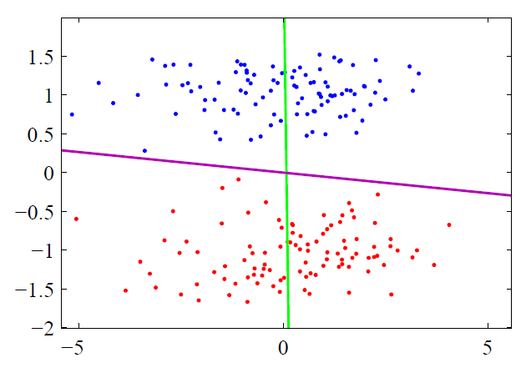
Motivation
Projection that best separates the data in a least-squares sense:
PCA finds components that are useful for representing data.
Pooling (or projecting) data may discard essential information for discriminating between data in different classes.
PCA finds the direction for maximum data variance (unsupervised/generative).
LDA (Linear Discriminant Analysis) or MDA (Multiple Discriminant Analysis) finds the direction that optimally separates data of different classes (supervised/discriminative).
LDA
PCA
LDA projection
PCA projection

Slide 4
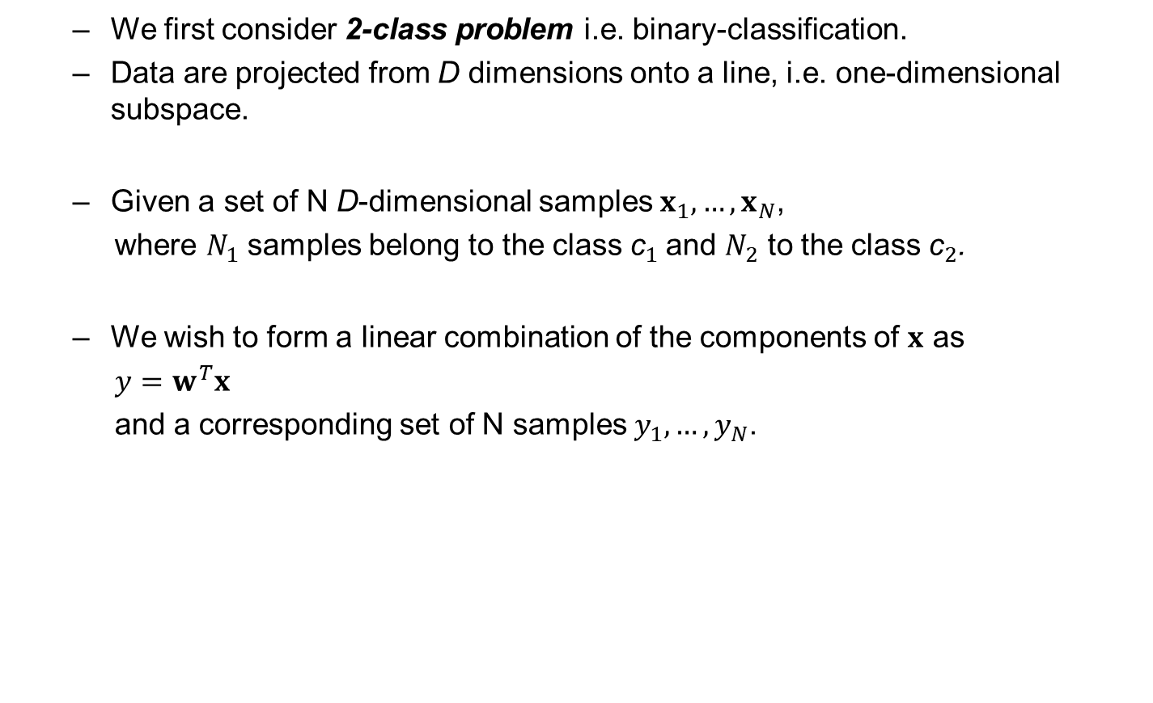
Fisher Linear Discriminant (FLD)
We first consider 2-class problem i.e. binary-classification.
Data are projected from D dimensions onto a line, i.e. one-dimensional subspace.
Given a set of N D-dimensional samples $x_{1},…,x_{N}$,
where $N_{1}$ samples belong to the class ${\text{c}}_{1}$and $N_{2}$ to the class ${\text{c}}_{2}$.
We wish to form a linear combination of the components of $x$ as
$y=w^{T}x$
and a corresponding set of N samples $y_{1},…,y_{N}$.

Slide 5
FLD: two-dimensional example
Projection of same set of two-class samples onto two different lines in the direction marked w.
Classes mixed
Better separation

Slide 6

Finding best direction w
Class mean in D-dimensional space:
$$m_{i}=\frac{1}{N_{i}}\sum_{x∈c_{i}}{x}$$
Class mean of projected points:
${\tilde{m}}_{i}=\frac{1}{N_{i}}\sum_{y∈c_{i}}{y}=$ $\frac{1}{N_{i}}\sum_{x∈c_{i}}{w^{T}x}=w^{T}m_{i}$
Distance between projected class means is
$${\left|{\tilde{m}}_{1}−{\tilde{m}}_{2}\right|=|w}^{T}\left(m_{1}−m_{2}\right)|$$

Slide 7
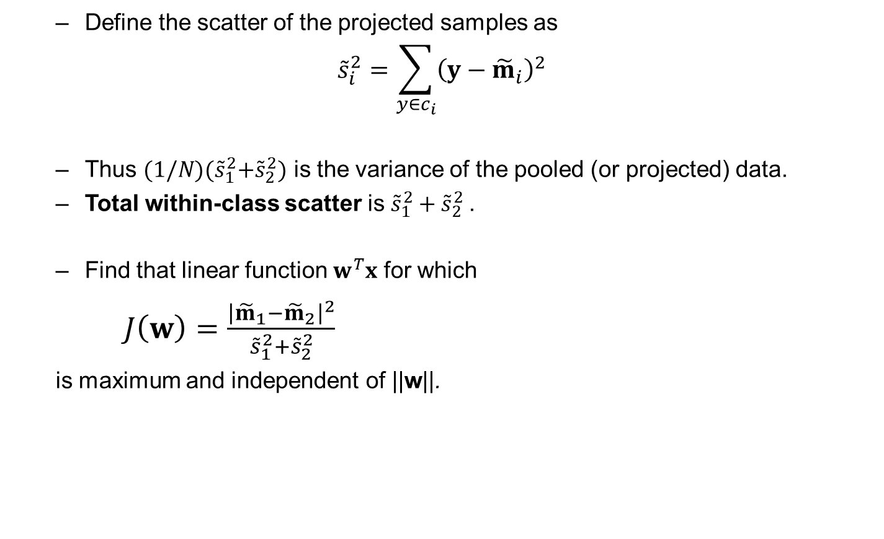



Criterion for Fisher Linear Discriminant
Define the scatter of the projected samples as
$${\tilde{s}}_{i}^{2}=\sum_{y∈c_{i}}{{\left(y−{\tilde{m}}_{i}\right)}^{2}}$$
Thus ${(1/N)(\tilde{s}}_{1}^{2}+{\tilde{s}}_{2}^{2})$ is the variance of the pooled (or projected) data.
Total within-class scatter is ${\tilde{s}}_{1}^{2}+{\tilde{s}}_{2}^{2}$.
Find that linear function $w^{T}x$ for which
$J\left(w\right)=\frac{{\left|{\tilde{m}}_{1}−{\tilde{m}}_{2}\right|}^{2}}{{\tilde{s}}_{1}^{2}+{\tilde{s}}_{2}^{2}}$
is maximum and independent of ||w||.
$${\tilde{s}}_{1}^{2}$$
$$\left|{\tilde{m}}_{1}−{\tilde{m}}_{2}\right|$$
$${\tilde{s}}_{2}^{2}$$

Slide 8
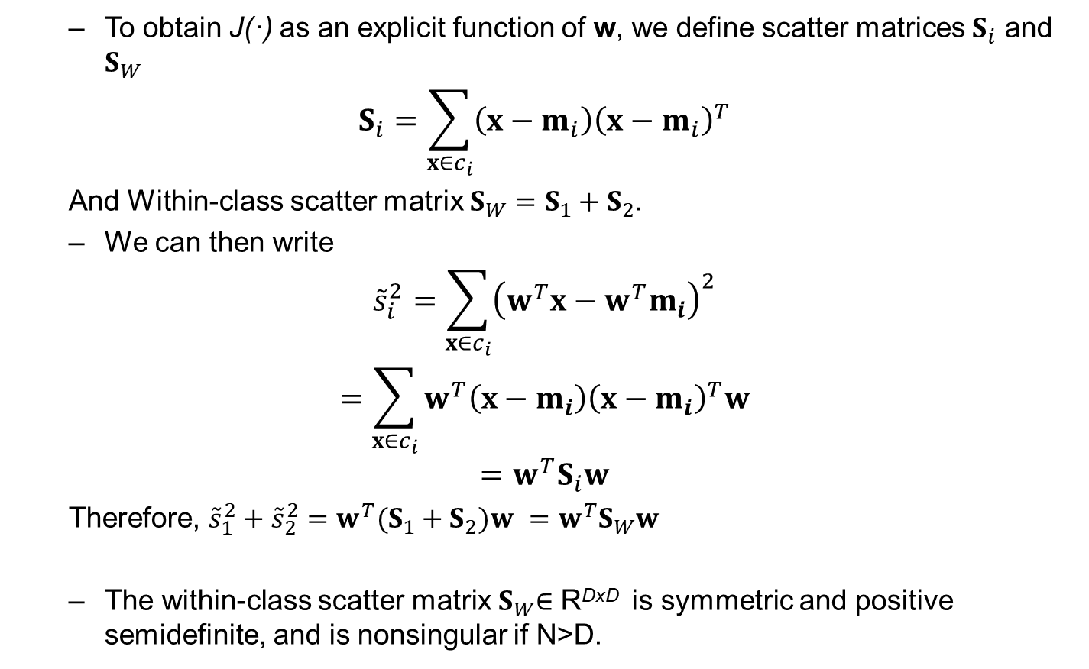
Scatter matrices
To obtain J(·) as an explicit function of w, we define scatter matrices $S_{i}$ and $S_{W}$
$$S_{i}=\sum_{x∈c_{i}}{{\left(x−m_{i}\right)\left(x−m_{i}\right)}^{T}}$$
And Within-class scatter matrix $S_{W}=S_{1}+S_{2}$.
We can then write
$${\tilde{s}}_{i}^{2}=\sum_{x∈c_{i}}{{\left(w^{T}x−w^{T}m_{i}\right)}^{2}}$$
$$=\sum_{x∈c_{i}}{{w^{T}\left(x−m_{i}\right)\left(x−m_{i}\right)}^{T}w}$$
$$=w^{T}S_{i}w$$
Therefore, ${\tilde{s}}_{1}^{2}+{\tilde{s}}_{2}^{2}={w^{T}(S_{1}+S_{2})w =w}^{T}S_{W}w$
The within-class scatter matrix $S_{W}$∈ R^{DxD} is symmetric and positive semidefinite, and is nonsingular if N>D.

Slide 9
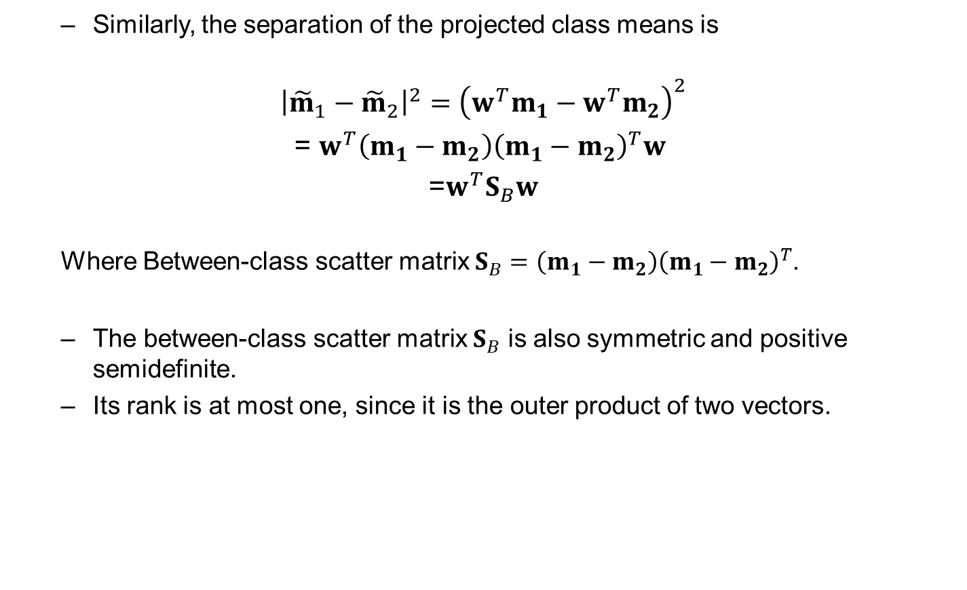
Scatter matrices
Similarly, the separation of the projected class means is
$${\left|{\tilde{m}}_{1}−{\tilde{m}}_{2}\right|}^{2}={\left(w^{T}m_{1}−w^{T}m_{2}\right)}^{2}$$
= $w^{T}\left(m_{1}−m_{2}\right){\left(m_{1}−m_{2}\right)}^{T}w$
=$w^{T}S_{B}w$
Where Between-class scatter matrix $S_{B}=\left(m_{1}−m_{2}\right){\left(m_{1}−m_{2}\right)}^{T}$.
The between-class scatter matrix $S_{B}$ is also symmetric and positive semidefinite.
Its rank is at most one, since it is the outer product of two vectors.

Slide 10
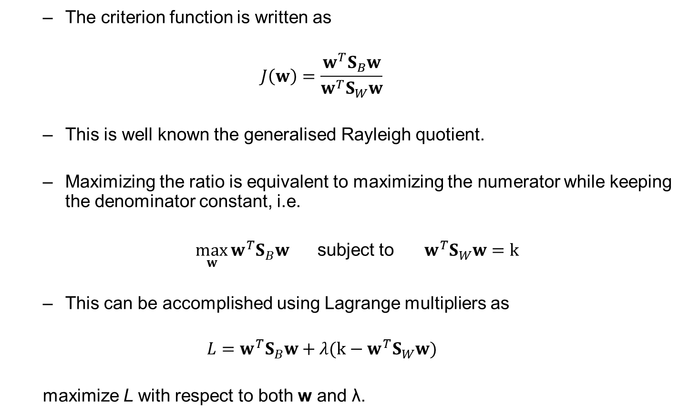
Criterion function in terms of scatter matrices and optimisation
The criterion function is written as
$$J\left(w\right)=\frac{w^{T}S_{B}w}{w^{T}S_{W}w}$$
This is well known the generalised Rayleigh quotient.
Maximizing the ratio is equivalent to maximizing the numerator while keeping the denominator constant, i.e.
$\max_{w}{{w^{T}S}_{B}w}$ subject to $w^{T}S_{W}w=k$
This can be accomplished using Lagrange multipliers as
$$L={w^{T}S}_{B}w+λ({k−w}^{T}S_{W}w)$$
maximize L with respect to both w and λ.

Slide 11
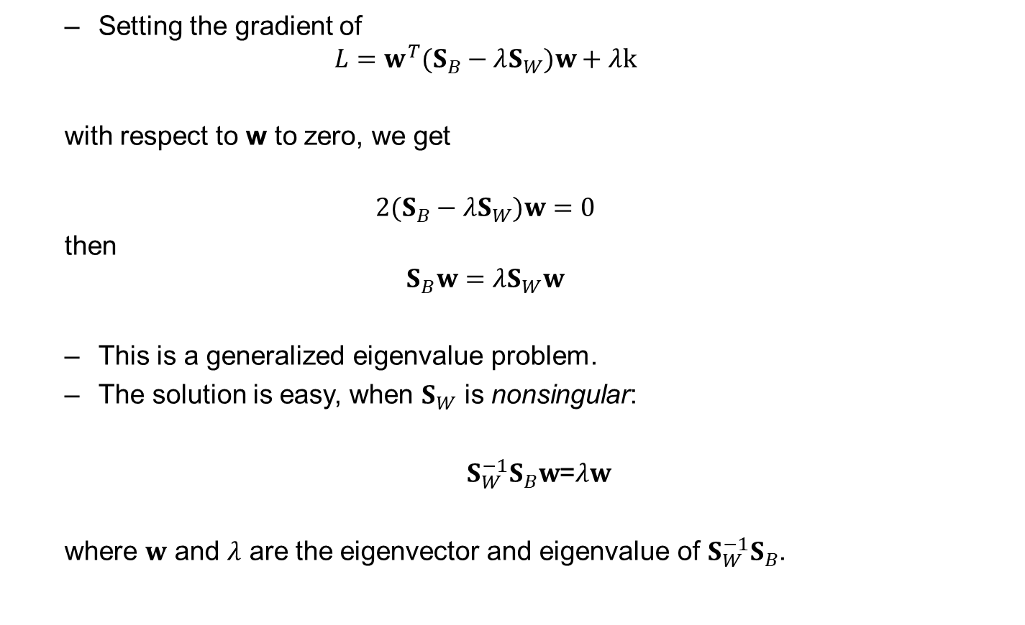
Optimisation for Fisher Discriminant
Setting the gradient of
$$L={w^{T}(S}_{B}−λS_{W})w+λk$$
with respect to w to zero, we get
$${2(S}_{B}−λS_{W})w=0$$
then
$$S_{B}w=λS_{W}w$$
This is a generalized eigenvalue problem.
The solution is easy, when $S_{W}$ is nonsingular:
${S_{W}^{−1}S}_{B}w$=$λw$
where $w$ and $λ$ are the eigenvector and eigenvalue of ${S_{W}^{−1}S}_{B}$.

Slide 12
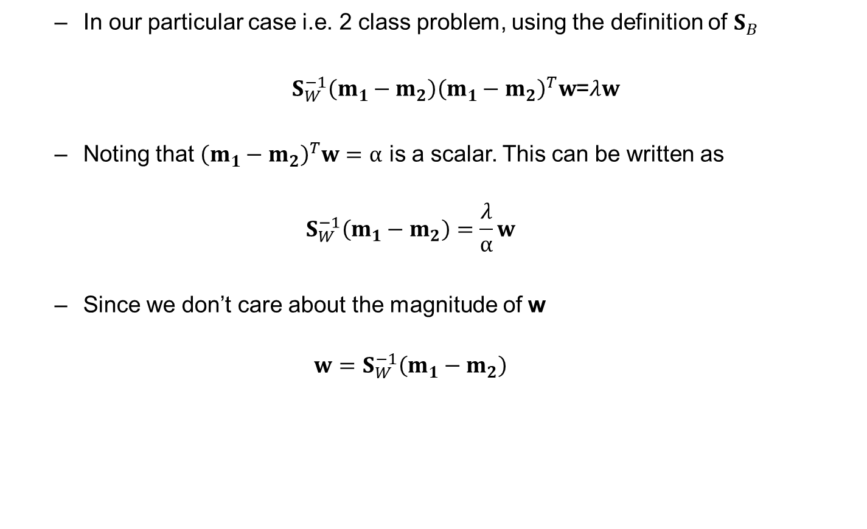
Optimisation for Fisher Discriminant
In our particular case i.e. 2 class problem, using the definition of $S_{B}$
$S_{W}^{−1}\left(m_{1}−m_{2}\right){\left(m_{1}−m_{2}\right)}^{T}w$=$λw$
Noting that ${\left(m_{1}−m_{2}\right)}^{T}w=α$ is a scalar. This can be written as
$$S_{W}^{−1}\left(m_{1}−m_{2}\right)=\frac{λ}{α}w$$
Since we don’t care about the magnitude of w
$$w=S_{W}^{−1}\left(m_{1}−m_{2}\right)$$

Slide 13
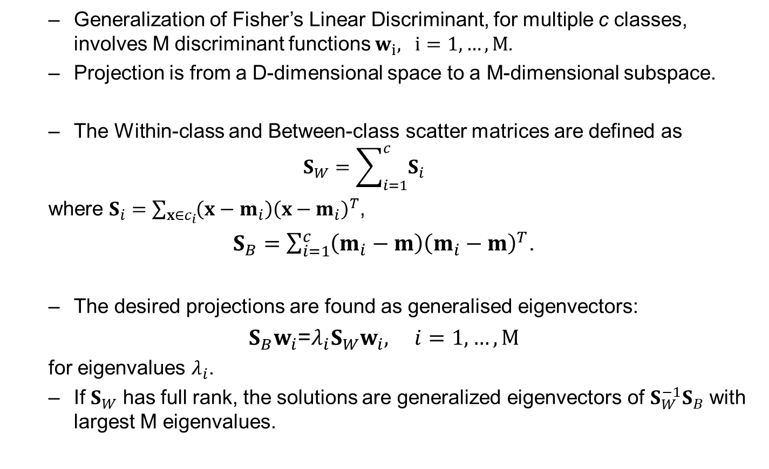
Multiple Discriminant Analysis
Generalization of Fisher’s Linear Discriminant, for multiple c classes, involves M discriminant functions $w_{i}, i=1,…,M$.
Projection is from a D-dimensional space to a M-dimensional subspace.
The Within-class and Between-class scatter matrices are defined as
$$S_{W}=\sum_{i=1}^{c}{S_{i}}$$
where $S_{i}=\sum_{x∈c_{i}}{{\left(x−m_{i}\right)\left(x−m_{i}\right)}^{T}}$,
$S_{B}=\sum_{i=1}^{c}{\left(m_{i}−m\right){\left(m_{i}−m\right)}^{T}}$.
The desired projections are found as generalised eigenvectors:
$S_{B}w_{i}$=$λ_{i}S_{W}w_{i}, i=1,…,M$
for eigenvalues $λ_{i}$.
If $S_{W}$ has full rank, the solutions are generalized eigenvectors of ${S_{W}^{−1}S}_{B}$ with largest M eigenvalues.

Slide 14
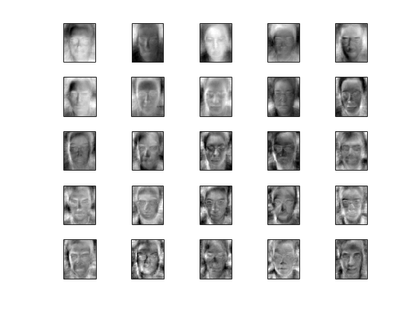
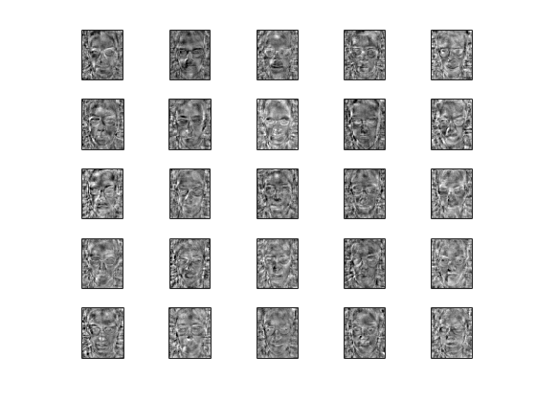
Fisherfaces
Eigenfaces
Fisherfaces
vs
P. Belhumeur, J. Hespanha, D. Kriegman, Eigenfaces vs. Fisherfaces: recognition using class specific linear projection, TPAMI, 1997.

Slide 15
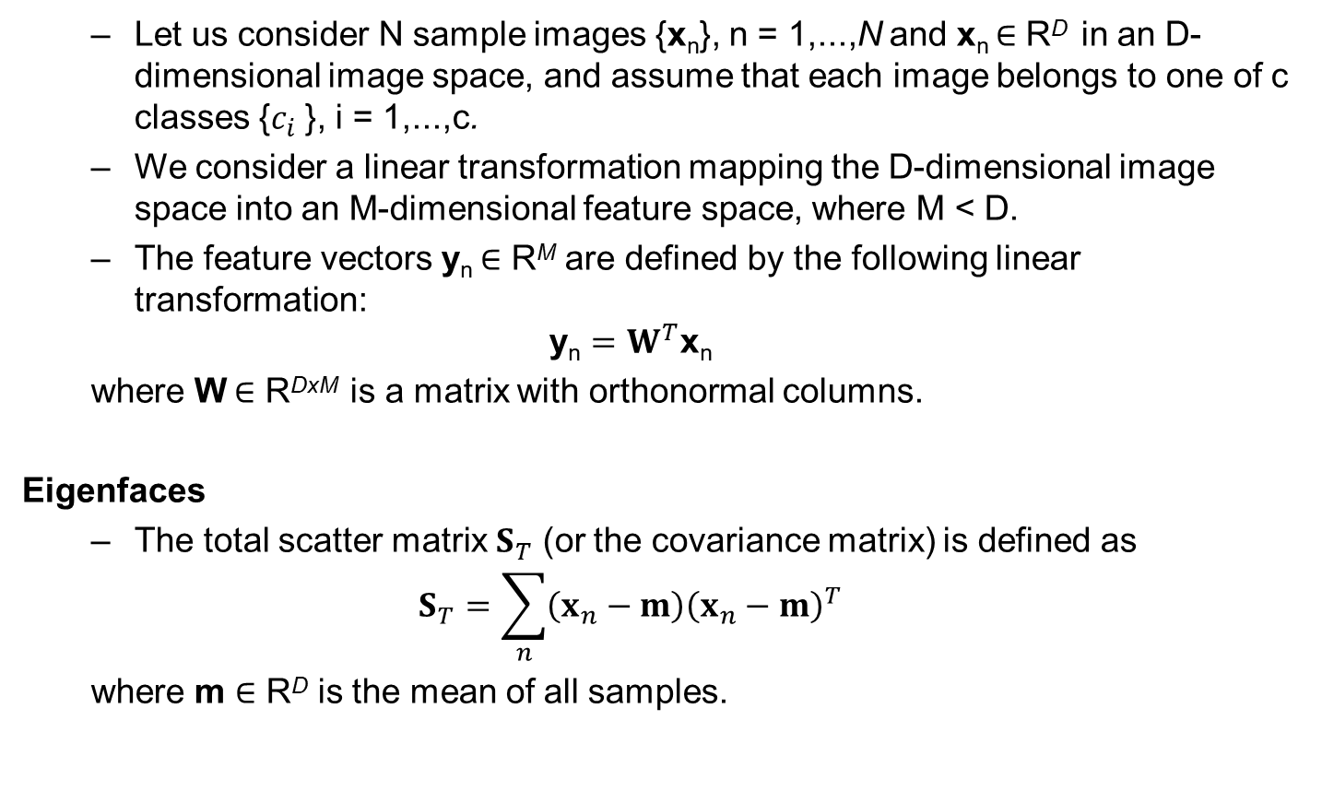
Recognition using class specific linear projection
Let us consider N sample images {x_{n}}, n = 1,...,N and x_{n} ∈ R^{D} in an D-dimensional image space, and assume that each image belongs to one of c classes {$c_{i}$}, i = 1,...,c.
We consider a linear transformation mapping the D-dimensional image space into an M-dimensional feature space, where M < D.
The feature vectors y_{n} ∈ R^{M} are defined by the following linear transformation:
$$\text{y}\text{n}=W^{T}\text{x}\text{n}$$
where W ∈ R^{DxM} is a matrix with orthonormal columns.
Eigenfaces
The total scatter matrix $S_{T}$ (or the covariance matrix) is defined as
$$S_{T}=\sum_{n}{{\left(x_{n}−m\right)\left(x_{n}−m\right)}^{T}}$$
where m ∈ R^{D} is the mean of all samples.

Slide 16
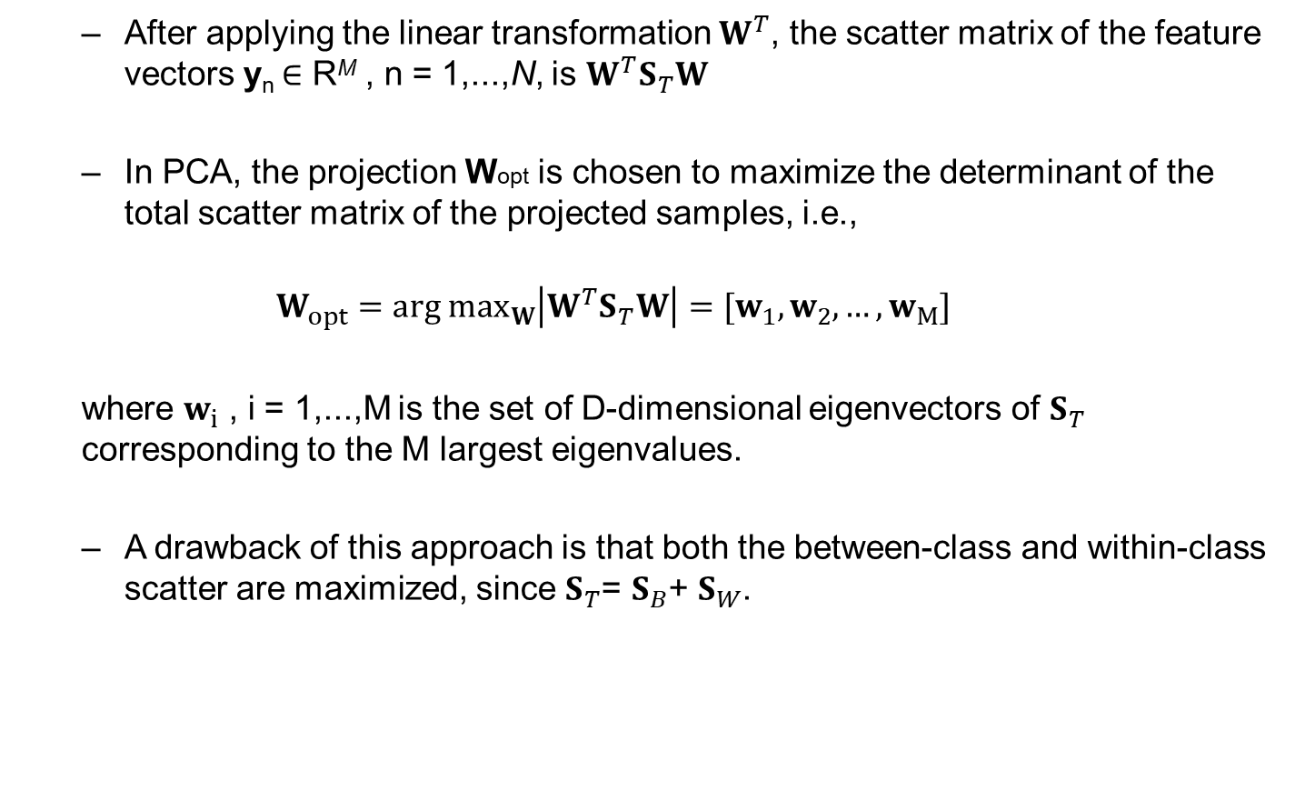
Recognition using class specific linear projection
After applying the linear transformation $W^{T}$, the scatter matrix of the feature vectors y_{n} ∈ R^{M} , n = 1,...,N, is $W^{T}S_{T}W$
In PCA, the projection Wopt is chosen to maximize the determinant of the total scatter matrix of the projected samples, i.e.,
$$W_{opt}=arg \max_{W}\left|W^{T}S_{T}W\right|=[w_{1},w_{2},…,w_{M}]$$
where $w_{i}$ , i = 1,...,M is the set of D-dimensional eigenvectors of $S_{T}$ corresponding to the M largest eigenvalues.
A drawback of this approach is that both the between-class and within-class scatter are maximized, since $S_{T}$= $S_{B}$+ $S_{W}$.

Slide 17
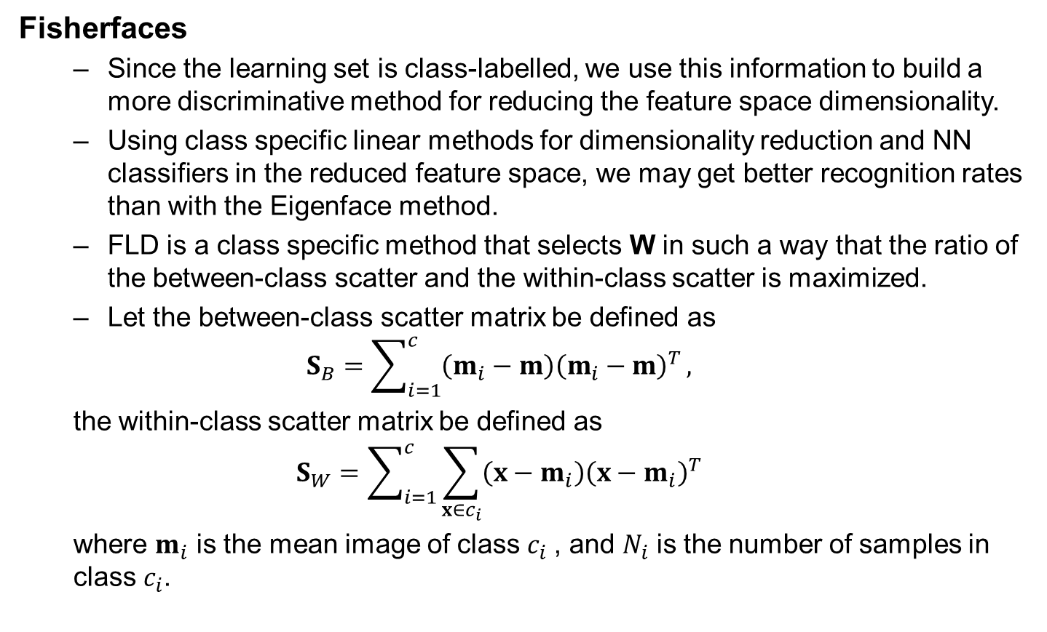
Recognition using class specific linear projection
Fisherfaces
Since the learning set is class-labelled, we use this information to build a more discriminative method for reducing the feature space dimensionality.
Using class specific linear methods for dimensionality reduction and NN classifiers in the reduced feature space, we may get better recognition rates than with the Eigenface method.
FLD is a class specific method that selects W in such a way that the ratio of the between-class scatter and the within-class scatter is maximized.
Let the between-class scatter matrix be defined as
$$S_{B}=\sum_{i=1}^{c}{\left(m_{i}−m\right){\left(m_{i}−m\right)}^{T}},$$
the within-class scatter matrix be defined as
$$S_{W}=\sum_{i=1}^{c}{\sum_{x∈c_{i}}{{\left(x−m_{i}\right)\left(x−m_{i}\right)}^{T}}}$$
where $m_{i}$ is the mean image of class $c_{i}$, and $N_{i}$ is the number of samples in class $c_{i}$.

Slide 18
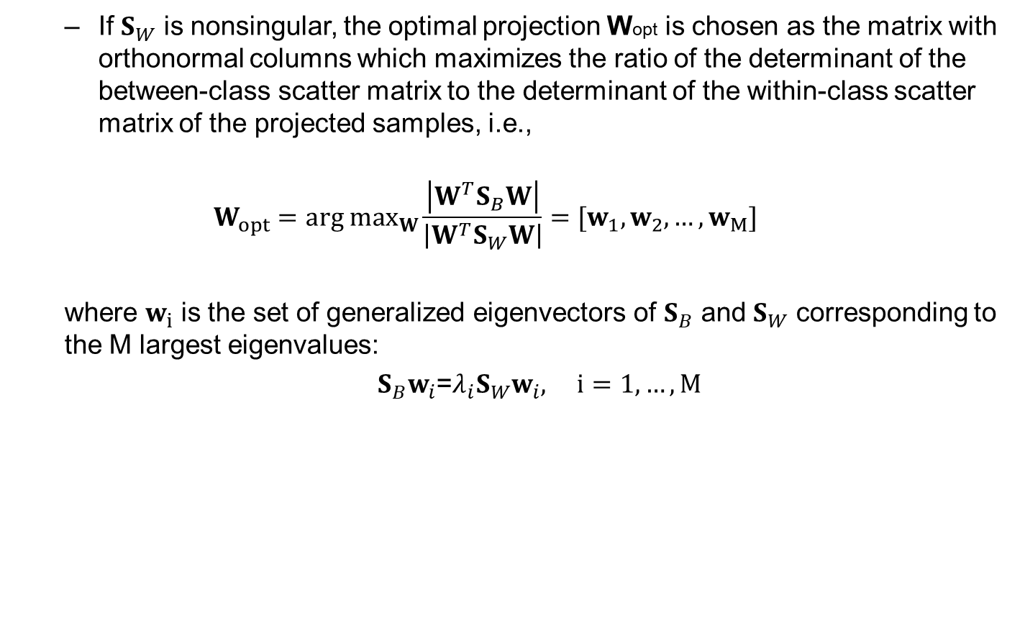
Fisherfaces
If $S_{W}$ is nonsingular, the optimal projection Wopt is chosen as the matrix with orthonormal columns which maximizes the ratio of the determinant of the between-class scatter matrix to the determinant of the within-class scatter matrix of the projected samples, i.e.,
$$W_{opt}=arg \max_{W}\frac{\left|W^{T}S_{B}W\right|}{\left|W^{T}S_{W}W\right|}=[w_{1},w_{2},…,w_{M}]$$
where $w_{i}$ is the set of generalized eigenvectors of $S_{B}$ and $S_{W}$ corresponding to the M largest eigenvalues:
$S_{B}w_{i}$=$λ_{i}S_{W}w_{i}, i=1,…,M$

Slide 19
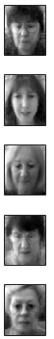












Procedures: Fisherfaces
Collect training images x_{n} of c classes (c=26, N=208, D=2576)
Compute the class means $m_{i}$, i = 1,…,c, and the global mean $m$
W
$$m_{1}$$
H
$$c_{1}$$
$$c_{2}$$
$$m_{2}$$
$$c_{3}$$
$$m_{3}$$
$$m$$
$$c_{4}$$
$$m_{4}$$
$$c_{5}$$
..
.
$$m_{5}$$

Slide 20
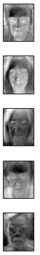

















Procedures: Fisherfaces
Compute $m_{i}−m$, and $S_{B}$, where rank($S_{B}$) = c -1.
W
$$m_{1}$$
$$m_{1}−m$$
H
$$c_{1}$$
$$c_{2}$$
$$m_{2}$$
$$m_{2}−m$$
$$c_{3}$$
$$m_{3}$$
$$m$$
$$m_{3}−m$$
$$c_{4}$$
$$m_{4}$$
$$m_{4}−m$$
$$c_{5}$$
..
.
$$m_{5}$$
$$m_{5}−m$$

Slide 21
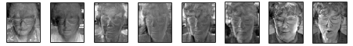
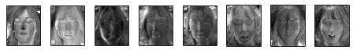
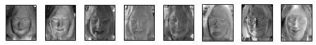
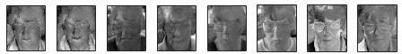
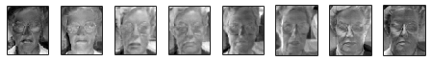

Procedures: Fisherfaces
Compute$x−m_{i}$, and $S_{W}$, where rank($S_{W}$) is N – c.
W
$$m_{1}$$
H
$$c_{1}$$
$$c_{2}$$
$$m_{2}$$
$$c_{3}$$
$$m_{3}$$
$$c_{4}$$
$$m_{4}$$
$$c_{5}$$
..
.
$$m_{5}$$

Slide 22

Fisherfaces
Given the generalized eigenvalue/vector problem of $S_{B}$ and $S_{W}$:
$S_{B}w_{i}$=$λ_{i}S_{W}w_{i}, i=1,…,M$
Note that there are at most c - 1 nonzero generalized eigenvalues i.e. the rank of $S_{B}$, and so an upper bound on M is c - 1.
The within-class scatter matrix $S_{W}$∈R^{DxD} is often singular, since the rank of $S_{W}$ is at most N - c, and, in general, N is smaller than D.

Slide 23
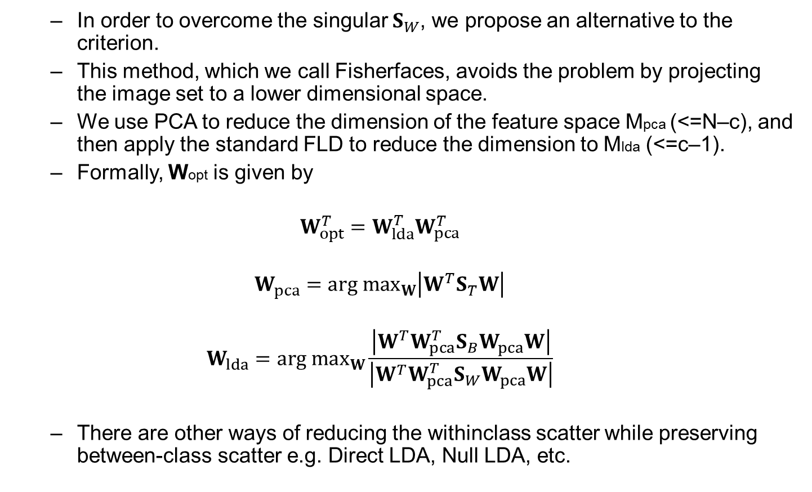
Fisherfaces
In order to overcome the singular $S_{W}$, we propose an alternative to the criterion.
This method, which we call Fisherfaces, avoids the problem by projecting the image set to a lower dimensional space.
We use PCA to reduce the dimension of the feature space Mpca (<=N–c), and then apply the standard FLD to reduce the dimension to Mlda (<=c–1).
Formally, Wopt is given by
$$W_{opt}^{T}=W_{lda}^{T}W_{pca}^{T}$$
$$W_{pca}=arg \max_{W}\left|W^{T}S_{T}W\right|$$
$$W_{lda}=arg \max_{W}\frac{\left|W^{T}{W_{pca}^{T}S}_{B}W_{pca}W\right|}{\left|W^{T}{W_{pca}^{T}S}_{W}W_{pca}W\right|}$$
There are other ways of reducing the withinclass scatter while preserving between-class scatter e.g. Direct LDA, Null LDA, etc.

Slide 24
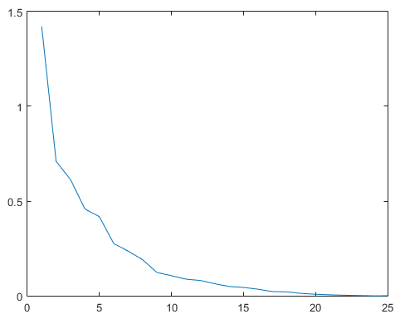
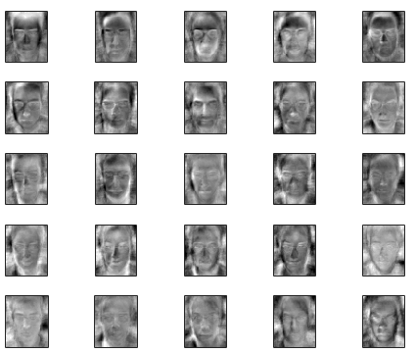

Procedures: Fisherfaces
rank(Sw) = 182 (=N – c), rank(Sb) = 25 (=c – 1)
Perform PCA to get $W_{pca}$ (Mpca=25), and compute ${W_{pca}^{T}S}_{B}W_{pca}$ and ${W_{pca}^{T}S}_{W}W_{pca}$.
Get the generalized eigenvectors of ${{(W_{pca}^{T}S}_{W}W_{pca})}^{−1}({W_{pca}^{T}S}_{B}W_{pca})$with largest Mlda eigenvalues.
Generalized eigenvalues
Top 25 generalized eigenvectors

Slide 25
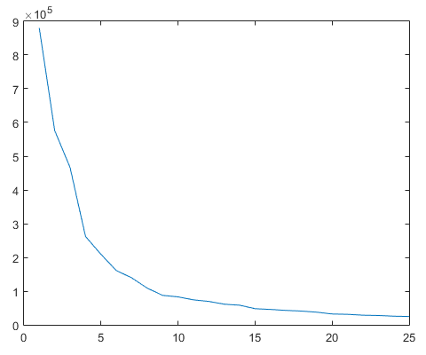
Comparison to Eigenfaces
Eigenvalues
Top 25 eigenvectors

Slide 26
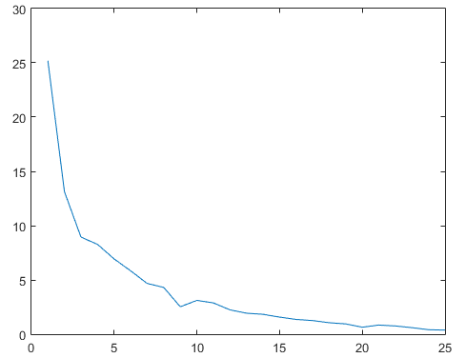

Procedures: Fisherfaces
rank(Sw) = 182 (=N – c), rank(Sb) = 25 (=c – 1)
Perform PCA to get $W_{pca}$ (Mpca=150), and compute ${W_{pca}^{T}S}_{B}W_{pca}$ and ${W_{pca}^{T}S}_{W}W_{pca}$.
Get the generalized eigenvectors of ${{(W_{pca}^{T}S}_{W}W_{pca})}^{−1}({W_{pca}^{T}S}_{B}W_{pca})$with largest Mlda eigenvalues.
Generalized eigenvalues
Top 25 generalized eigenvectors

Slide 27
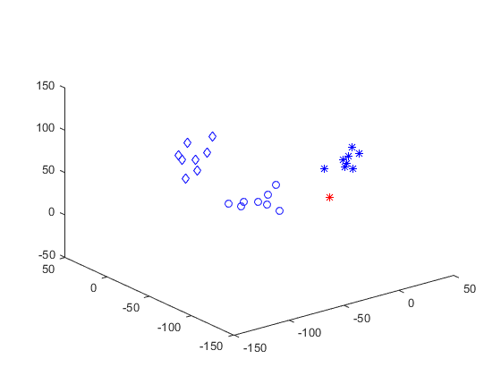
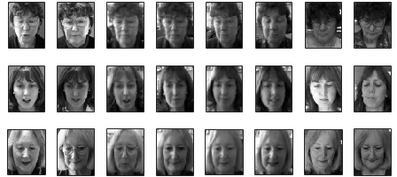
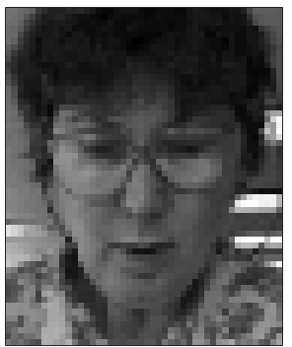
Procedures: Fisherfaces
u₃
u₁
u₂
Face images in 3-dimensional fisher-subspace
24 training images of 3 different face classes (star, diamond, circle, “in blue”) are projected. A query image projection is “in red”.

Slide 28
Comparison to Eigenfaces
u₃
u₁
u₂
Face images in 3-dimensional eigen-subspace
24 training images of 3 different face classes (star, diamond, circle, “in blue”) are projected. A query image projection is “in red”.

Slide 29
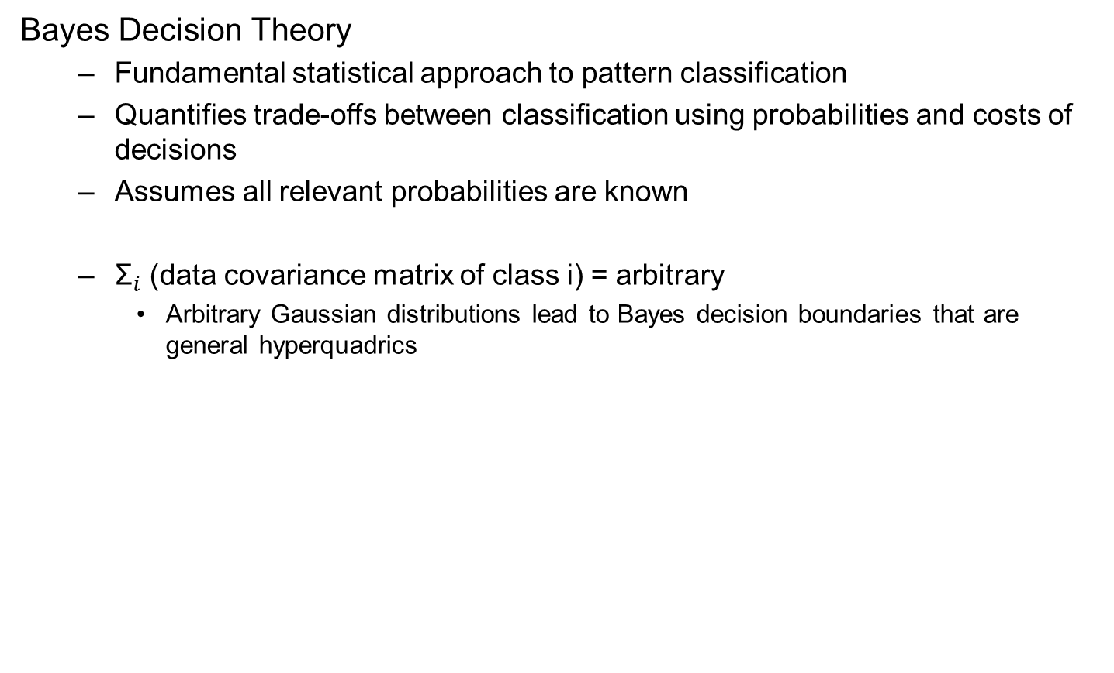
Relation to optimal bayesian decision theory
Bayes Decision Theory
Fundamental statistical approach to pattern classification
Quantifies trade-offs between classification using probabilities and costs of decisions
Assumes all relevant probabilities are known
${\text{Σ}}_{i}$ (data covariance matrix of class i) = arbitrary
Arbitrary Gaussian distributions lead to Bayes decision boundaries that are general hyperquadrics

Slide 30
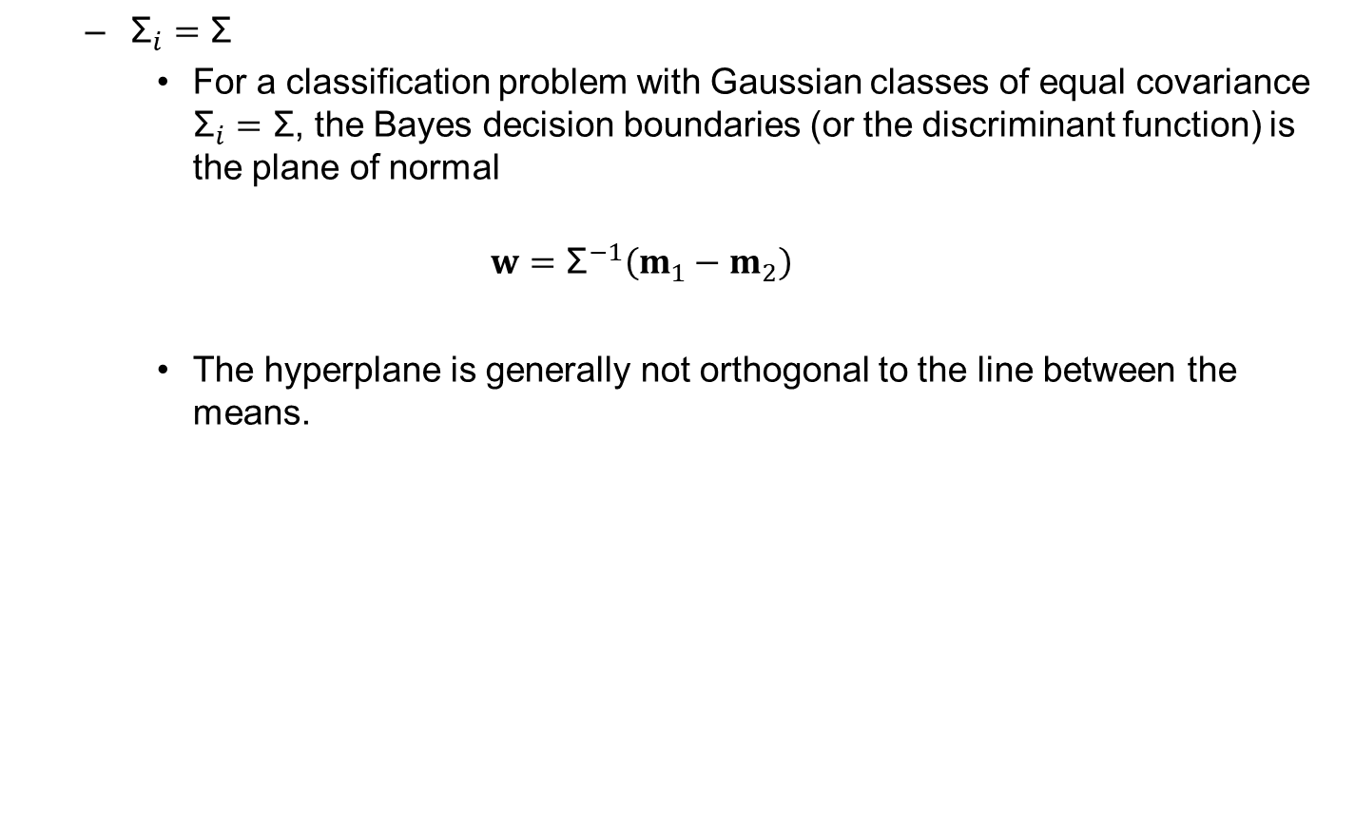
Relation to optimal bayesian decision theory
${\text{Σ}}_{i}=\text{Σ}$
For a classification problem with Gaussian classes of equal covariance ${\text{Σ}}_{i}=\text{Σ}$, the Bayes decision boundaries (or the discriminant function) is the plane of normal
$$w={\text{Σ}}^{−1}\left(m_{1}−m_{2}\right)$$
The hyperplane is generally not orthogonal to the line between the means.

Slide 31

Relation to optimal bayesian decision theory
If ${\text{Σ}}_{1}$= ${\text{Σ}}_{2}$, this is also the FLD solution.
In FLD, $S_{W}=S_{1}+S_{2}, w=S_{W}^{−1}\left(m_{1}−m_{2}\right)$
This gives some interpretations of FLD/LDA
It is optimal if and only if the classes are Gaussian and have equal covariance.
The extension from two-classes to multiple classes in LDA is ad-hoc.
T-K Kim, PhD dissertation: Discriminant Analysis of Patterns in Images, Image Ensembles, and Videos, Univ. of Cambridge, 2008.

